Slide 1
Infant Tracker
Michael Lamelza, Steven Putt, Connor Tree
CSPB - 3308

Slide 2
Infant Tracker Purpose and Benefits
Purpose
Provide new parents with an easy way to follow their infant’s habits
Benefits
Plan the next nap
Catch unusual bathroom habits
Maintain a feeding schedule
Monitor multiple babies

Slide 3
Tools Used – Project Management
Azure DevOps
Github
Discord
Tedious to setup and manage permissions
Easy to use once setup
Used the “Scrum” process
2-Week Sprints
Utilized Features, Backlogs and Tasks
Weekly meetings versus Daily scrum
Did not use source control
Utilized for source control
The basics are easy to use
Confusion grows with project complexity and users count
Plenty of resources and documentation
Handled all communication needs well (chat and calls)
Easy to setup and use

Slide 4
Tools Used – Development
Bootstrap (UI)
Flask
Heroku
Great HTML, CSS, Javascript GUI framework
Easy to use and implement
Web Server framework
Easy to setup
Good documentation
Great for a starter project
Hosting site
Easy to setup
Need to explore more capabilities
SQLite
VSCode
Languages
Great for small projects
Limited in functionality (“lite” indeed)
Very easy to setup and distribute databases
Integrated Development Environment (IDE)
Powerful but somewhat overwhelming
Good documentation
“There’s an extension for that”
Python
SQLite
Typescript/Javascript
HTML
CSS

Slide 5
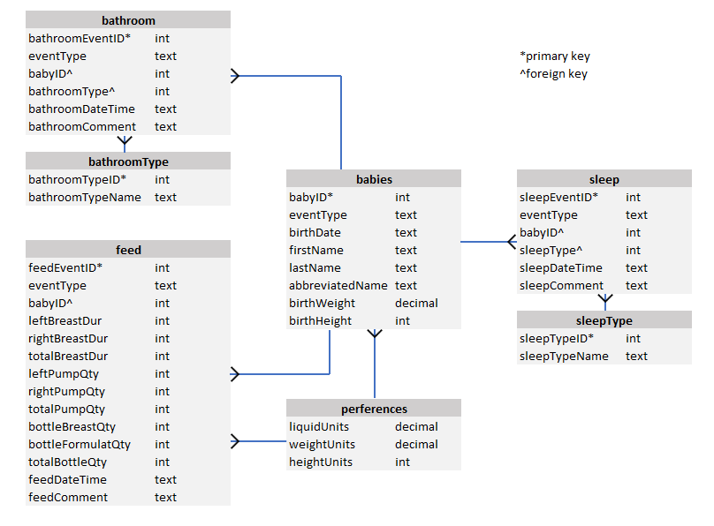
Database
Unique ID based primary keys
Foreign keys for dependent tables
Foreign key constraints

Slide 6
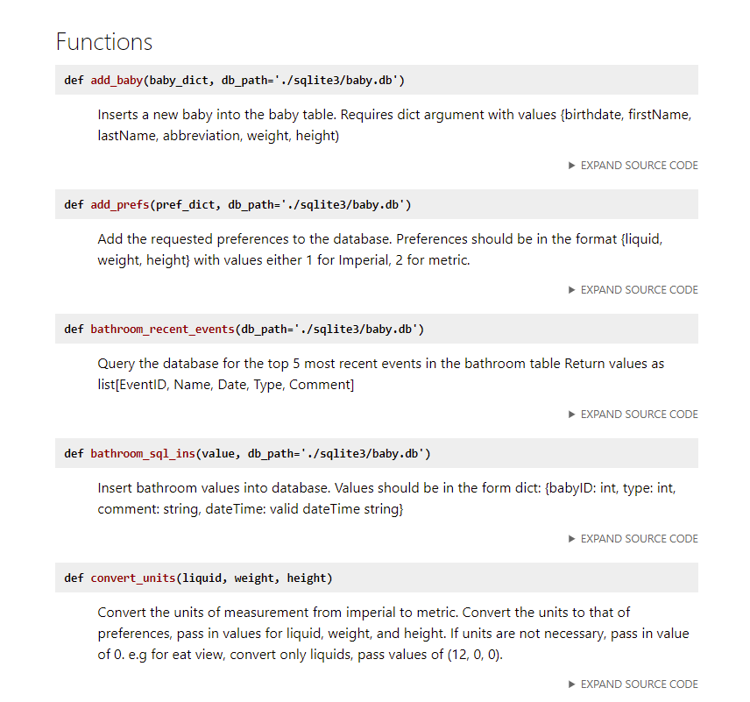
Testing and Documentation
PDOC Examples
Tests for 4 main menus
Unit Tests
Regression Tests
User Acceptance Tests
Documentation
Readme
Autodoc - Pdoc

Slide 7


Challenges
Issue
External factors
Unknowns
Edge cases
Solution
Stay Agile!!!
Prioritization
Testing
Adjustments
A detailed tabular editor was dropped in favor of tabular views by menu
Charts and trends were deprioritized due to time constraints. Focus shifted to thorough testing and polish on existing menus

Slide 8
Demo
Infant Tracker

Slide 9
Questions?

Slide 10
FROM MOODLE
Your presentation should cover the following:
Project Title
Team members' names
All the tools your team used
Name of the tool and purpose
Your team's evaluation of the tool: usefulness, ease of use, ...
Example Tools:
Project tracker
Version control
database
testing
auto-documenter
deployment environment
programming languages and frameworks
code editors, development environments
Project
Purpose
Major features
Database Design
Testing
Documentation
Design Challenges you encountered
How you overcame them
How your plans changed
Demonstration of your project
frontend
backend
database access

Slide 11
“Script”
Slides 1-3 (Connor – 3 min)
Slides 4-7 (Steve – 3 min)
Demo Front End (Michael – 5 min)
Demo Back End ? (Connor – 1 minute)
Demo Database ? (Steve – 1 minute)

